Slide 1
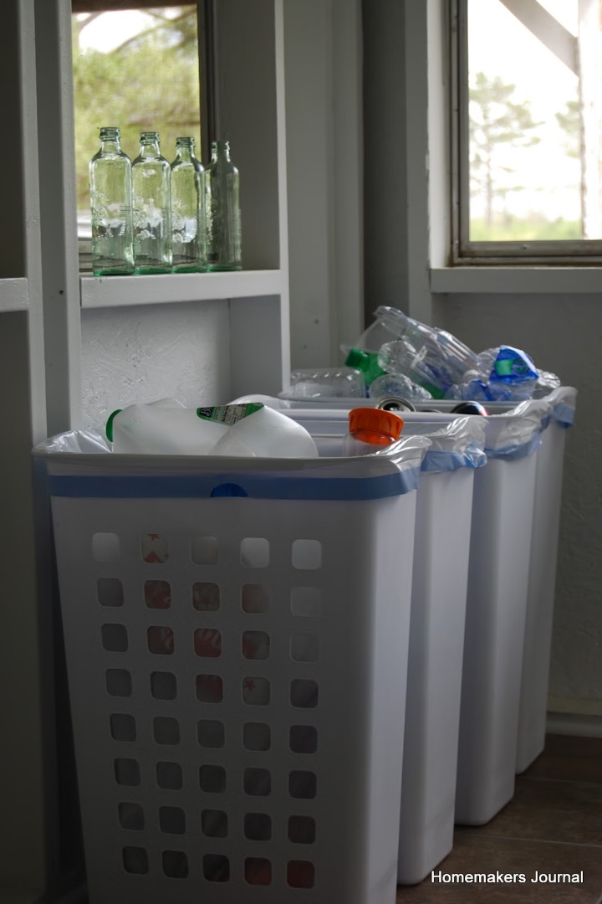
Scrap Management System: A Digital Solution for Sustainable Waste Management
In today's world, where resource depletion, climate change, and environmental degradation are becoming increasingly evident, waste management stands as one of the most critical challenges facing societies globally. The accumulation of scrap materials—ranging from metals, plastics, e-waste, paper, and glass—has grown at an alarming rate. This mini project, undertaken as part of the Engineering Exploration Lab (EEL), aimed to design a digital system in the form of an HTML website that streamlines scrap collection, sorting, recycling, and disposal.
BY- B24CE1054: ASMI TATAWAR
B24CE1055: NIRAJ FEGDE
B24CE1056: JANHAVI PATIL
B24CE1057: OM CHANDURKAR
B24CE1058: ATHARVA BHONDE

Slide 2
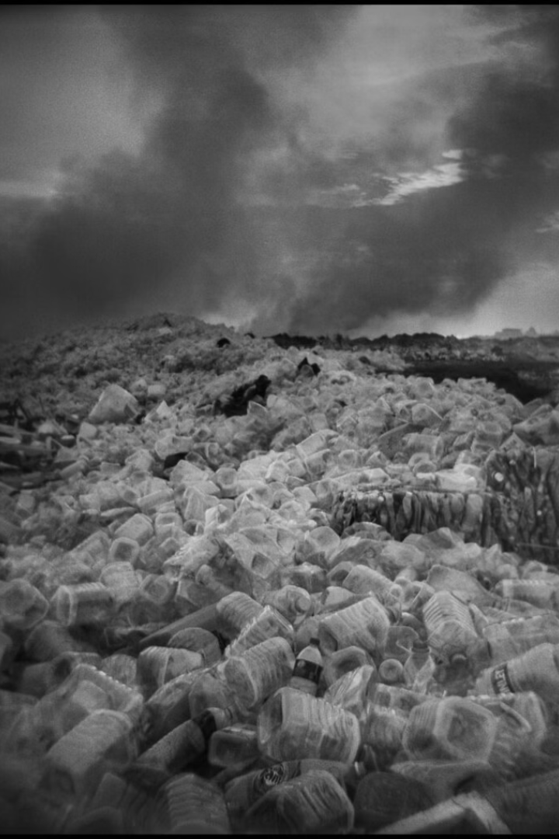
The Need for a Scrap Management System
Environmental Impact
Resource Depletion
Improper waste disposal exacerbates environmental damage, impacting ecosystems, public health, and natural resources.
The increasing global population and consumption contribute to the depletion of natural resources.
Sustainability
The Scrap Management System aims to reduce landfill waste, conserve natural resources, and promote sustainability through better recycling practices.

Slide 3
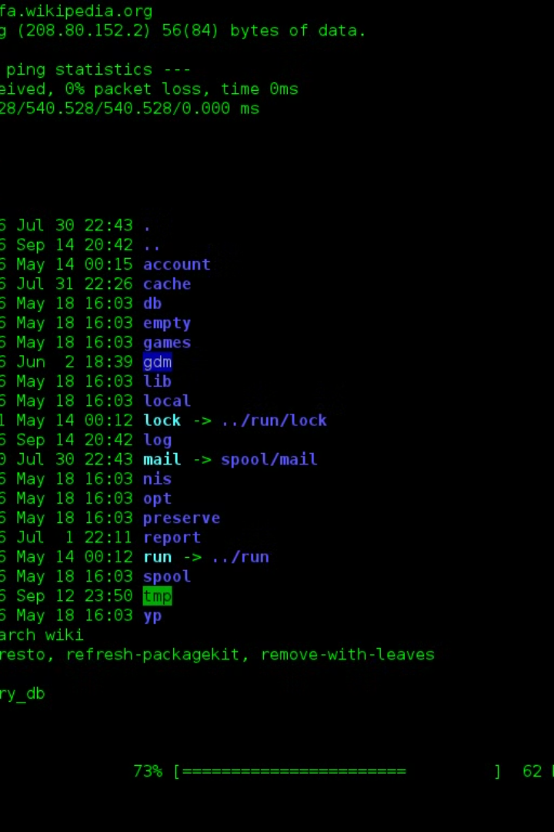
About the Scrap Management System (SMS)
The Scrap Management System (SMS) is a digital solution designed to offer an end-to-end approach to scrap material handling. It supports multiple functionalities to ensure that scrap materials are collected, sorted, recycled, and disposed of in an environmentally secure manner. This system is not just a technical tool, but a vital part of a broader movement toward promoting sustainability, reducing waste, and ensuring that valuable resources are used efficiently.

Slide 4
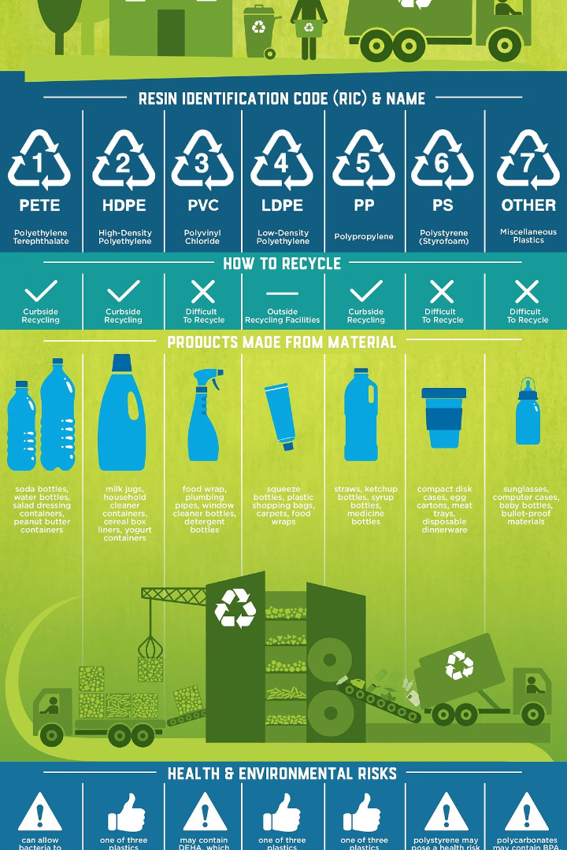
Key Functionalities of the SMS
1
Scrap Collection and Registration
2
Sorting and Categorization
The system categorizes materials into various groups, such as metals, plastics, electronics, paper, and glass, guiding users on proper sorting based on recyclability and local regulations.
Users can register scrap materials by entering key data such as type, weight, condition, and estimated value.
3
Tracking and Reporting
4
Collaboration with Recycling Centers
The system monitors the quantity and type of scrap materials being processed and recycled, generating detailed reports on recycling efforts and environmental impact.
The system connects users directly with local recycling facilities, enabling users to easily find nearby centers and coordinate pickups or drop-offs.

Slide 5
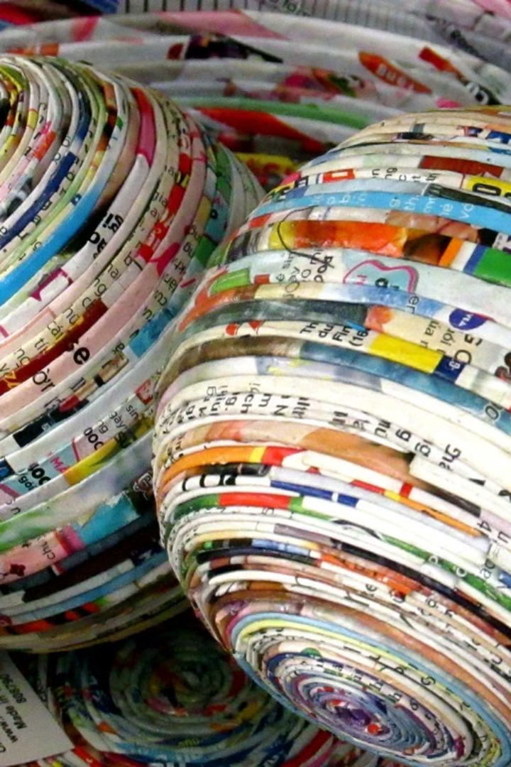
Creation of an HTML Website for the SMS
To further enhance the usability and accessibility of the Scrap Management System, we have developed a dedicated HTML-based website. This website serves as the primary interface for users to interact with the system, register scrap materials, track progress, and access resources on recycling.

Slide 6
The Scrap Management System Website
User Registration Portal
Interactive Dashboard
Recycling Center Locator
A simple and secure way for users to sign up, create an account, and start registering their scrap materials.
Provides users with real-time data on their recycling efforts, including the amount of material recycled, environmental impact, and other metrics.
An interactive map that allows users to locate nearby recycling centers and view their services, operating hours, and types of materials accepted.

Slide 7

Motive Behind the Topic: Environmental Security
The primary motive behind the development and implementation of the Scrap Management System is to enhance environmental security. With growing environmental concerns surrounding pollution, resource depletion, and waste mismanagement, this system represents a proactive solution to mitigate these challenges.

Slide 8




Key Environmental Concerns Addressed
Soil and Water Pollution
Scrap materials, particularly electronics and certain plastics, often contain hazardous substances such as heavy metals, lead, mercury, and chemicals. If improperly disposed of, these materials can leach harmful toxins into the soil and water systems, causing contamination that can affect both ecosystems and human populations.
Air Pollution
Open burning of scrap materials releases harmful pollutants into the atmosphere, including particulate matter and toxic gases. These pollutants contribute to climate change and pose serious health risks.
Resource Depletion
Recycling scrap materials reduces the need to mine or harvest new raw materials, promoting the efficient use of existing resources and building a sustainable circular economy.
Energy Consumption
Recycling typically uses less energy than the production of new materials from raw sources. The Scrap Management System encourages the recycling of energy-intensive materials, leading to significant reductions in overall energy consumption and carbon emissions.

Slide 9

Conclusion
The Scrap Management System offers a comprehensive, efficient, and sustainable solution to one of the most significant environmental challenges of our time—waste management. By enhancing the process of collecting, sorting, recycling, and disposing of scrap materials, the system empowers individuals, businesses, and communities to actively participate in reducing waste, conserving resources, and minimizing environmental impact.

Slide 10
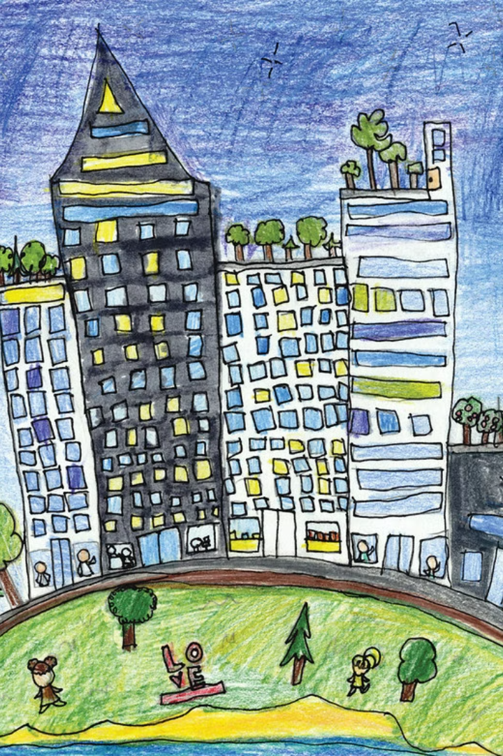
The Future of Sustainable Waste Management
The adoption of such systems on a global scale can contribute significantly to achieving sustainability goals, advancing circular economies, and fostering a greener, cleaner, and healthier future for generations to come. Through collective efforts and responsible scrap management practices, we can make a positive impact on the environment, ensuring that we leave a sustainable world for future generations.
THANK YOU

